Slide 1
Enabling enterprise asset Intelligence in Manufacturing
Christine weber

Slide 2
agenda
Top Manufacturing Segments
Top Manufacturing Challenges
Continuous Improvement Initiatives
The Need for Printing
Leading Software Vendors
Zebra Printing Solutions
The Opportunity

Slide 3
MANUFACTURING VERTICAL
Top 10 MFg segments for zebra in 2014
APPX $500 Million in Growth/Size
Supplies, Desktop, Tabletop, Mobile line
Pharma / Med
Devices
Electronics
Food/Bev
CPG
MARKET GROWTH
Automotive
Textile
Chemical
Aerospace
Defense
Non-Auto Transport
Oil/Gas
MARKET SIZE
Notes:
This is where Zebra is projecting growth for the MFG vertical
Top ones are Automotive, Medical Devices and Electronics.

Slide 4
Top 5 MANUFACTURING challengEs
These challenges can greatly affect the supply chain and increase the risk of costly supply chain disruptions, additional administration cost, and challenges with product delivery to consumers.
Regulation
Strategic alignment
Increased labor
Pricing pressures
Market volatility
Notes:
They face very high Structural Cost Burden rate: high healthcare, labor, corporate taxes, tort litigation, etc.
Fact: US manufacturing Structural Cost Burden is now at 20% compared to 6% in China according to the U.S. Department of Commerce.
Manufacturers are looking for ways to automate systems to cut these cost incurred.
Another Challenge is regulatory compliance, trade + products certification. They include: OSHA, IMDS, GHS in Chemical, DQSA in Pharma, UDI in Medical Devices, etc. Just about every manufacturing sector has some form of post market surveillance and regulation.

Slide 5
Challenges Drive: Continuous Improvement Initiatives
Continuous Improvement Initiatives:
Returns Management
Throughput
Cost Management
Defects
Procurement
Material Sourcing
Sales Outbound
Drive Digital Voice Needs
Identifying Assets
Tracking Materials
Cycle Counts
Tracking Compliance
Through the use of Barcodes and RFID
Label Design
Printing
Reading
Managing Printers
Notes:
Your Oracle Warehouse Management, CRM, MES or ERP system is not complete unless you can connect the AutoID components back to the digital back office. Zebra provide these services for our partner community.

Slide 6
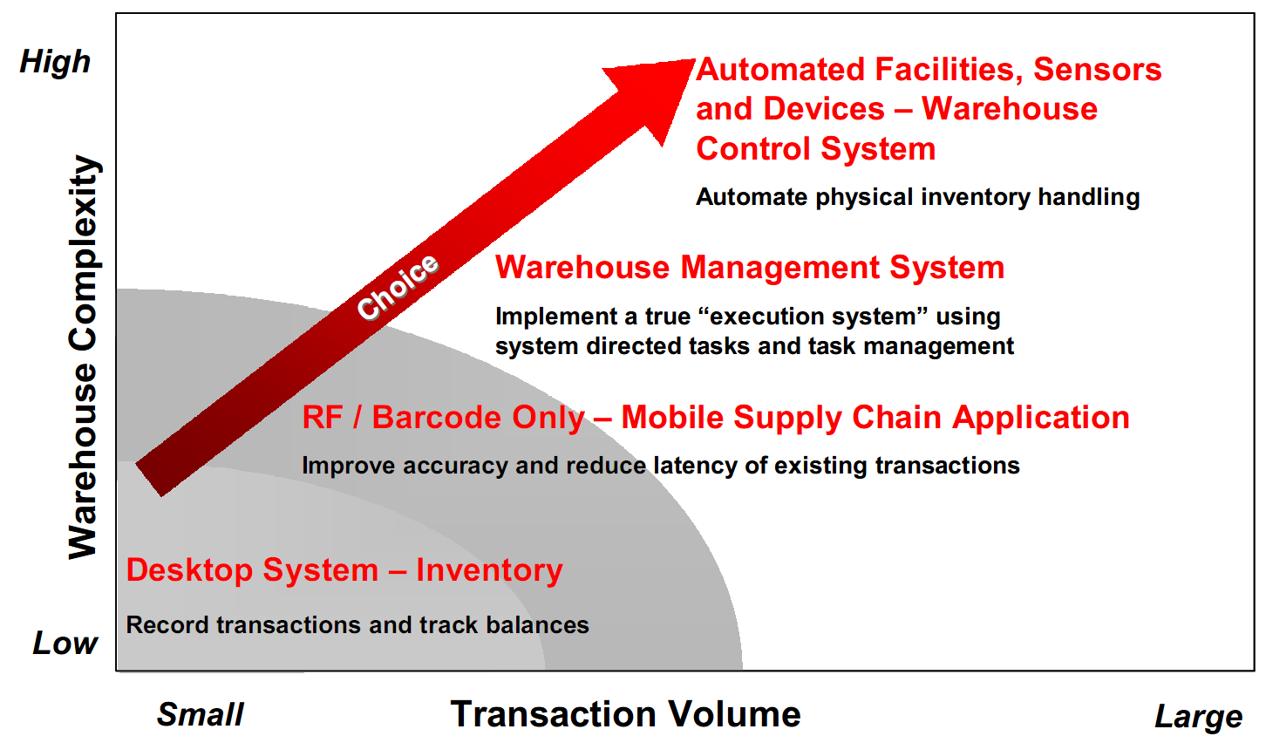
Tabletop & RFID printers Why they buy
Notes:
As the warehouse becomes more complex, the transaction volume becomes much larger. The typical manufacturers migration path includes integrating AutoID Technology and scale up to the right hardware. So, the smarter the warehouse, the more transactions.

Slide 7
Mobile Devices Why they buy
RUGGED
Role: All Workers
Activity: Low Volume Transaction
Devices: Rugged devices / rugged printers
Apps: Warehouse Management, Asset Mgmt
Transaction Complexity
Semi-Rugged
Role: Supervisor / Line Workers
Activity: Low Volume Transaction
Devices: Tablets / rugged printers
Apps: Inventory, Asset Mgmt
Smart
Devices
Role: Supervisor / Office Workers
Activity: Low Volume Transaction
Devices: Smartphones / non rugged printers
Apps: Inventory
Transaction Volume
Notes:
The same goes for Mobile Computers and printers in the warehouse and on the shop floor. As the transactions become more complex, the transaction volume increases. The typical manufacturers migration path includes integrating AutoID Technology and scale up to the right mobile hardware. So, the smarter the manufacturing & distribution facility, the more rugged devices needed.
Size of the bubble corresponds with the sized and volume of the transactions

Slide 8
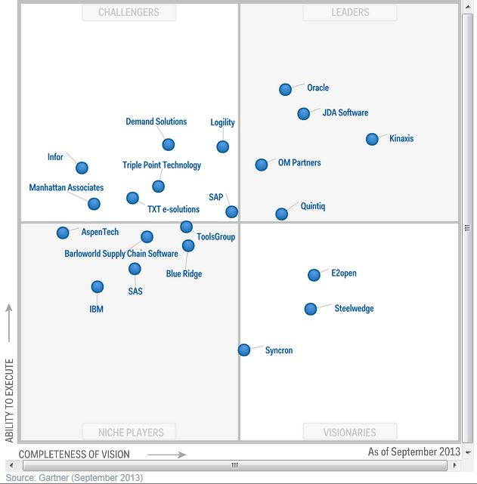
Leading software Vendors in MFG
Gartner Magic Quadrant -SCM
Drive AIDC Business
Barcode Printing
Labor management
Returns management
Lot tracking
Quality control
Shipment documentation
RFID compliance
Kitting and assembly
Voice-enabled capabilities
Post market surveillance
Output management
Multi-Modal shipping
Shop floor data collection
Label design software
Compliance solutions
Warehouse management
Supplies
Device management
Yard management
Asset management
Cloud printing
Notes:
Manufacturing Software vendors are getting closer to the shop-floor production. The ones circled are the leaders in Manufacturing
Vendors are providing flexible solutions for the next generation of manufacturing with a full range of manufacturing activities from planning to execution and analysis in one
single end-to-end system.
When an end-user selects a new software system, it drives investment in AIDC.

Slide 9
Manufacturing partner expectations
Think beyond the barcode
Know their applications and business challenges
Advise how they can leverage AIDC using their data to transform their business model and processes
Looking to speed time to market, deliver value and serve their customers needs
Notes:
I have met with quite a few manufacturers recently and the biggest thing they want is a partner that will act as a consultant to them. They want someone who understandd their business environment and make AIDC recommendations that will improve efficiency and lower their soft costs.

Slide 10
Zebra Printing solutions

Slide 11
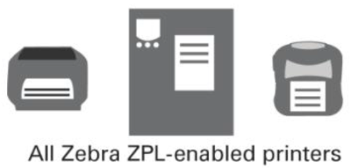
Printing Solutions for SAP
Certification
DATABASE
SAP Business Suites - ECC 6
OER / AII
DSD
XML
DATA
3rd Party ISV
SAP
Smartforms
SAP
SapScripts
ZPL
Notes:
Zebra is a member of the SAP PVP program (Printer Vendor Program). Partners since 1998.
All ZPL and RFID Printers are certified on the following SAP Module
-SAP Business Suites – Enterprise Central Component (ECC6)
-OER – Object Events Repository & A I I – AutoID Integration – for RFID Printers
-SAP Direct Store Delivery for Mobile Printers

Slide 12
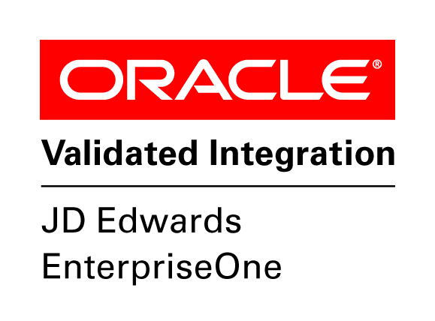
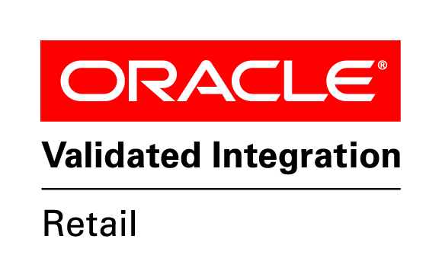
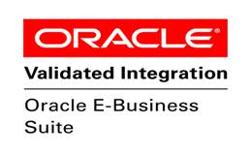
Printing Solutions for oracle
Current Certification
Notes:
Partners with Oracle since 2001. Oracle has validated Enterprise Connector using the following criteria
Zebra barcode solutions are functionally and technically sound,
Zebra barcode solutions use Oracle standards and are integrated with Oracle Applications in a reliable way
Zebra barcode solutions operate and perform as documented.
http://www.oracle.com/ocom/groups/public/@opnpublic/documents/webcontent/036607.pdf
First, It’s important to know that SAP has proprietary data formats, which thermal printers will not recognize unless SAP provides native support. Its also important to know that Zebra and SAP signed an agreement in 1998 (see attached) that provides native support for Zebra printers. This means that we are integrated into the SAP Kernel so every SAP Customer since 1998 can print natively from SAP. This is like saying they can print without doing or installing anything (Plug n Play). Cool Huh?
In the new SAP terminology, natively supported printers are called “certified device types.”
In 2006 SAP and Zebra performed compatibility and performance testing to certify Zebra device types for SAP. This includes ZPL-2, RFID Commands, Cutter & Reminder Commands etc.
Today, the SAP system must recognize the printer as a certified device type because the data streams and print commands need to be translated into a format the printer can recognize.
In summary, proprietary SAP data streams need to be translated to a proprietary thermal printer control language., i.e. ZPL. The translation can be handled several ways.
With that said Miss Christine, the most common printing methods are:
• Direct Connection–SAP use SAP SMARTFORMS to create ZPL label templates inside of SAP because the SAP kernel has native ZPL support for any ZPL-enabled printer, which are all recognized as a certified device types. The “translation” occurs within SAP before the print job is transmitted to the printer.
• SAPscript – We use Zebra Designer for mySAP to create the label templates outside of SAP, then upload the ZPL templates to the SAP system. These ZPL label formats are written and embedded into the SAP environment to provide compatibility with the respective ZPL printer.
• Direct XML – XML is used as the common data communication between SAP and the printer. We use Zebra Designer for XML to design the label and load the ZPL template in the respective printer’s memory. SAP’s data streams are sent out as XML directly to the printer for label printing and RFID encoding.
Emulation – The printer runs an emulator (IPL, DPL, etc.) that suppresses its own control language and emulates one that is supported by SAP. The competition emulate ZPL because SAP’s native output is ZPL (remember the attached from 1998)
• Middleware – SAP output is directed to the middleware software installed on a server, instead of going directly from SAP to the printer. The middleware translates the SAP output into a format the printer can recognize. (Loftware, Bartender, Niceware, Adobe Interactive Forms, etc.)
These options are available for all Zebra thermal printer models but they all have their advantages/disadvantage which are all here in the windmills of my mind!

Slide 13
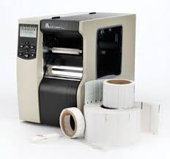
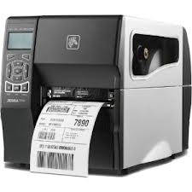
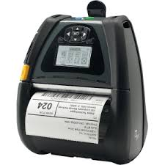
Delivering Value “COLLABORATE with partners to offer an integrated Solution”
PARTNER
Collaboration
3rd Party System
Delivering value
PRINTER HARDWARE
Zebra Software
Data
Events
API
Supplies, Alerts and Monitoring

Slide 14
Medical device manufacturer opportunity

Slide 15
opportunity
Medical
Devices
Food and Drug Administration (FDA) rule
Requires most medical devices distributed in the United States carry a unique device identifier, or UDI.
MARKET GROWTH
MARKET SIZE

Slide 16
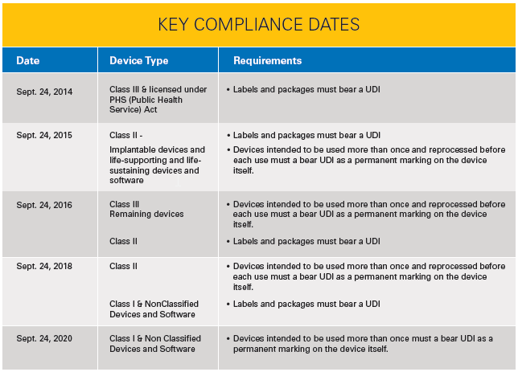
opportunity
Medical
Devices
MARKET GROWTH
MARKET SIZE

Slide 17
opportunity
Over 7,000 Medical Device Manufacturing locations in North America
Many of these are small companies, who will need help to become UDI compliant
Medical
Devices
MARKET GROWTH
MARKET SIZE

Slide 18
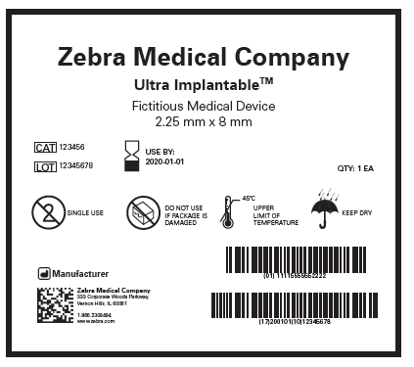
opportunity
UDI Compliance Pain Points
Redesigning labels to include:
GTIN Barcode
Production Identifier Barcode
Correct Date Format
Uploading required data to FDA’s GUDID database
Over 80 pieces of information required for each product
Medical
Devices
MARKET GROWTH
MARKET SIZE

Slide 19
opportunity
Additional Labeling Pain Points
Want to move from distributed to on-demand printing
Hard to determine the right label and ribbon combination to use:
Sterilization
Chemicals
Abrasion
Medical
Devices
MARKET GROWTH
MARKET SIZE

Slide 20
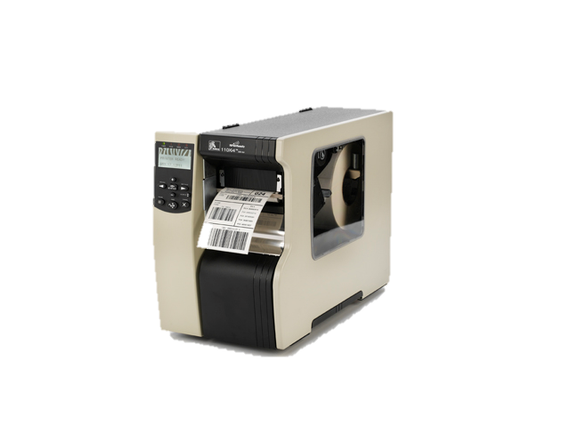
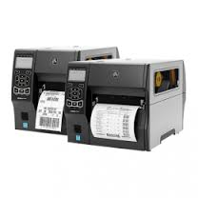
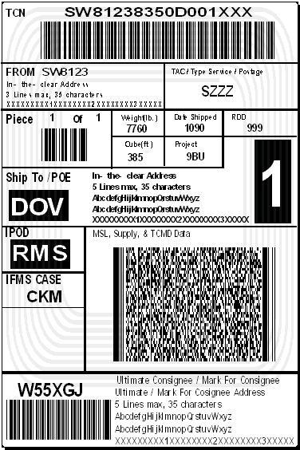
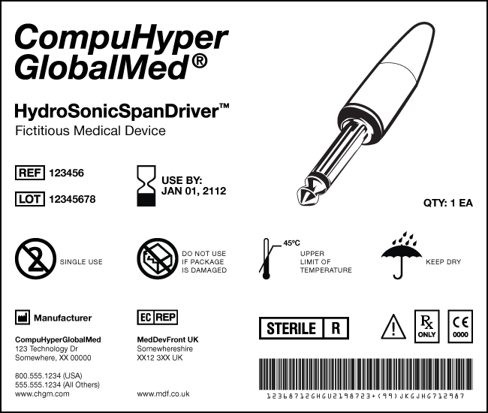
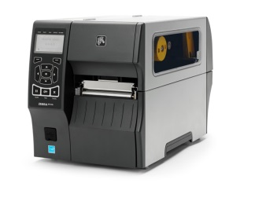
TOTAL INTEGRATED UDI SOLUTION
Zebra offers a total UDI solution
ZEBRA ISV partner now extend our portfolio offerings capabilities.
300dpi – 600dpi Printers
FDA
C
B
GS1
Pure
XML
Input
ISV
PARTNER
Pure
ZPL
Output
A
EXCEL
Upload ZPLTemplates to the
Kodit Cloud
ERP
Supplies
300dpi – 600dpi format
A
FDA HL7 Interface
B
ZPL Transport
C
Printer Hardware / Supplies

Slide 21
UDI BENEFITS
Accurate reporting, reviewing and analyzing of adverse event reports to enable quick identification and correction of problem devices:
Enable clinicians to quickly obtain important information on devices, reducing medical errors.
Enhance analysis of devices.
Provide a standard and clear way to document device use in HIT systems.
Increase effectiveness of management of medical device recalls.
Enable a global, secure supply chain, helping to address counterfeiting and diversion and prepare for medical emergencies.

Slide 22
Opportunity: Remove the AutoID Complexity from ERP
ENABLE
BE THE EXPERT IN
VISIBILITY
INFORMATION
KNOWLEDGE
PRINTING
TRACKING
TAGGING
LOCATING
BUILD
EXPAND REACH
INFORMED
SMART
SUCCESSFUL
VISIONARY
….CUSTOMERS
ALIGNMENT
Vertical Focused Solutions
ENABLEMENT
Know the Environment
GO TO MARKET
Engage with Customers around Solving Pain Points
Notes:
So What should your sales people have in mind as they engage companies in manufacturing?
First, they should understand that the customers ERP, MES, CRM systems are not complete until they can connect the physical movement of assets to the digital back office.
Second, Sales should work closely with their internal manufacturing subject matter expert and know the challenges within each manufacturing segment, Automotive, CPG, Electronic, Pharma, Medical …they are not created equal and they have various challenges.
We can achieve success together by developing, clear, customized strategies with specific implementation sales tactics.

Slide 23
Results in
Increased Throughput
Better Labor Management
Better Returns Management
Efficient Lot Tracking / Slotting
Improved Quality Control
Reduction in order-taking error rates
Reduction in order-fulfillment error rates
Automation of DSO (Days Sales Outstanding) rates
Elimination of cost of dispute resolutions
Elimination of inefficient/ineffective collection processes
Reduction in long-term losses due to customers going to better managed companies for product/services
Notes:
Increased Throughput
Reduction in order-taking error rates
Reduction in order-fulfillment error rates
Reduction in long-term losses due to customers going to better managed companies for product/services

Slide 24
questions

